Slide 1


Travel Review Ratings
Subject: Machine Learning
Presented By,
Rajaraman Ganesan - 251056279
Vatsal Shah - 251041322
Department of Electrical & Computer Engineering (M.Engg)
Western University, Canada

Slide 2
AGENDA
Introduction
Objective & Goal
Dataset description
Approach Design
Machine learning model
Results & Comparison - Python, R
Demo + AWS SageMaker
Conclusion
Future work & Technology used
*QR Code

Slide 3
Objective & Goal
Understand the process & difference by applying algorithms with custom models and pre-build libraries in Python
Apply algorithm in most-demanded languages in the industry - Python & R
Compare process, results and time complexity
Use Amazon SageMaker - understand the flow

Slide 4
AGENDA
Introduction
Objective & Goal
Dataset description
Approach Design
Machine learning model
Results & Comparison - Python, R
Demo + AWS SageMaker
Conclusion
Future work & Technology used
*QR Code

Slide 5

Dataset description
The model we built will use all factors on how the users are rated on various locations
Travel planning has become one of important commercial use.
Many tourists look for some places like malls, restaurants or vacation spots, etc. online in recent times.
Customers give feedback/rating, online so online reviews have become increasingly important.
Online review plays a critical role in the tourism industry, which mainly offers services and focuses on customer satisfaction.

Slide 6
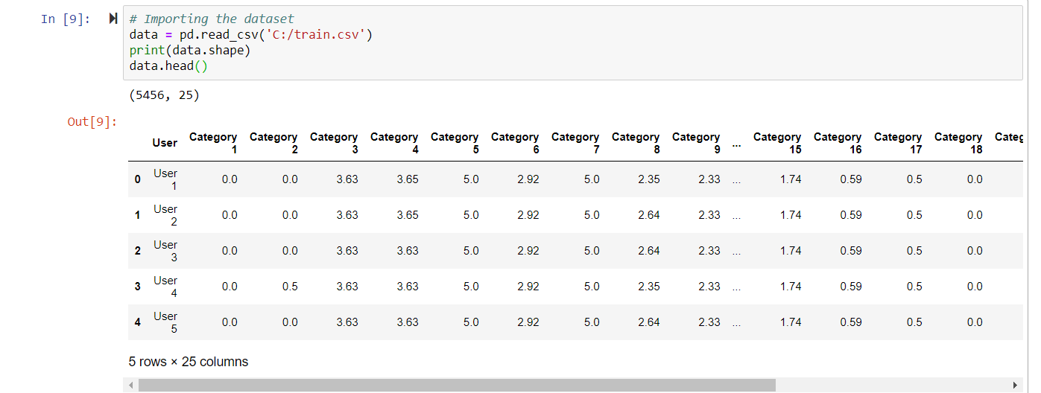
Dataset Overview
Oriented: UCI Machine Learning Repository (Link)
Attributes : 25
Tuples: 5456
Add for R, too

Slide 7
AGENDA
Introduction
Objective & Goal
Dataset description
Approach Design
Machine learning model
Results & Comparison - Python, R
Demo + AWS SageMaker
Conclusion
Future work & Technology used
*QR Code

Slide 8
Process Design
Unsupervised learning approach
Don't have a preliminary info on output values
Explore data to find some intrinsic structures in them
Use of clustering algorithm technique like k-means algorithm.

Slide 9
Approach Design
Preparation of data
Visualization Overview
Applying model
Apply custom model
Evaluate model

Slide 10
AGENDA
Introduction
Objective & Goal
Dataset description
Approach Design
Machine learning model
Results & Comparison - Python, R
Demo + AWS SageMaker
Conclusion
Future work & Technology used
*QR Code

Slide 11
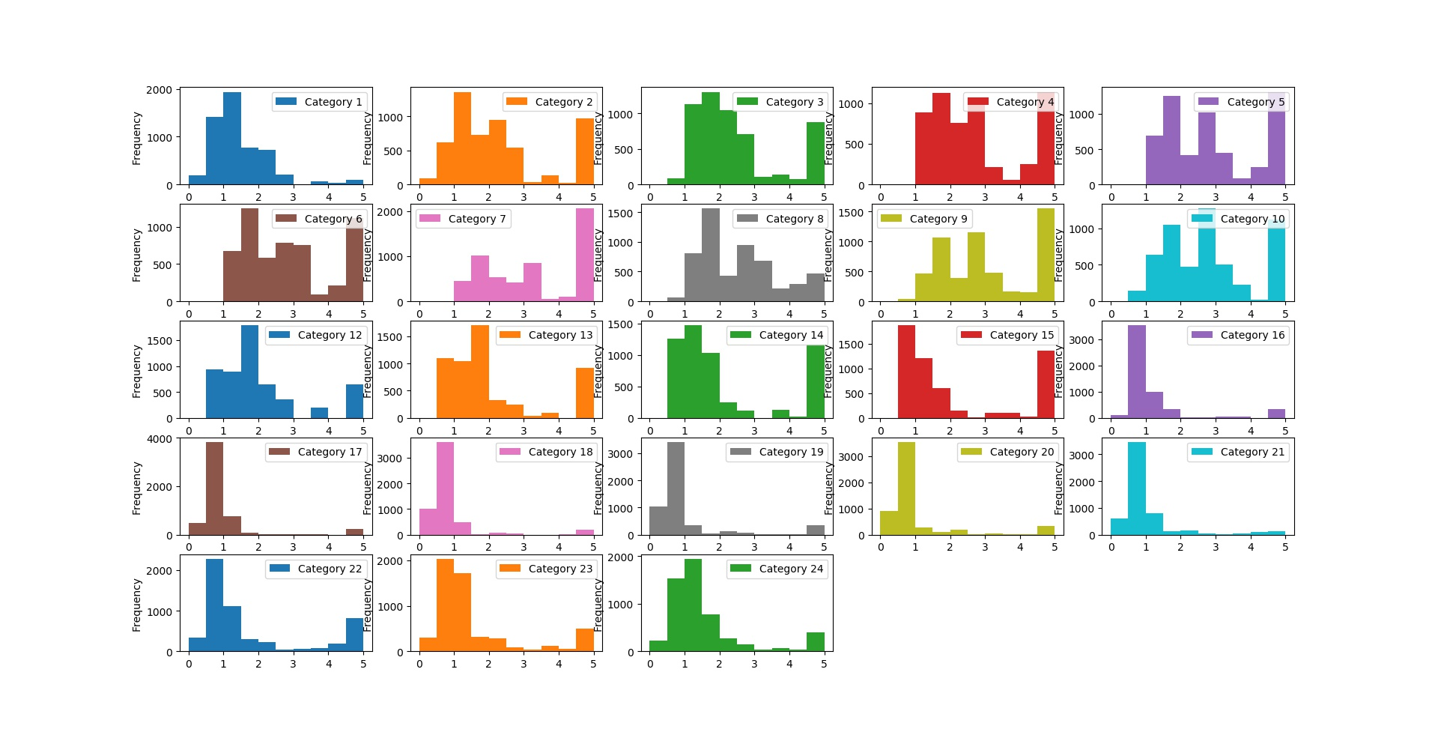
Visualization Overview
Shows 24 categories reviewed by users.

Slide 12
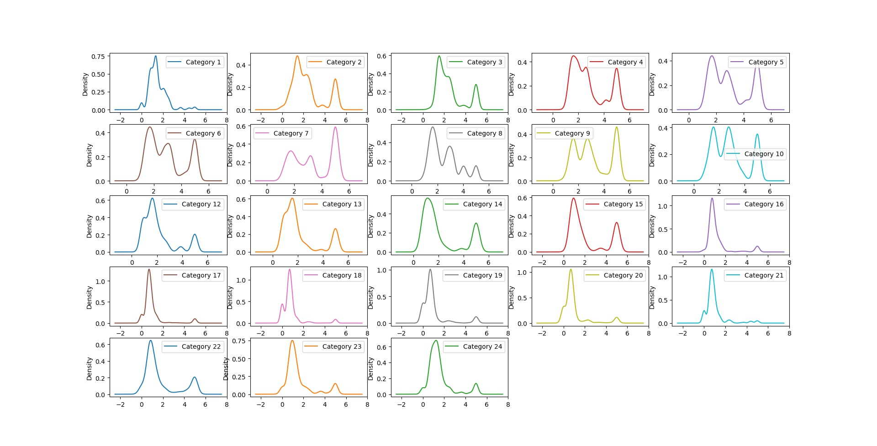
Visualization Overview

Slide 13
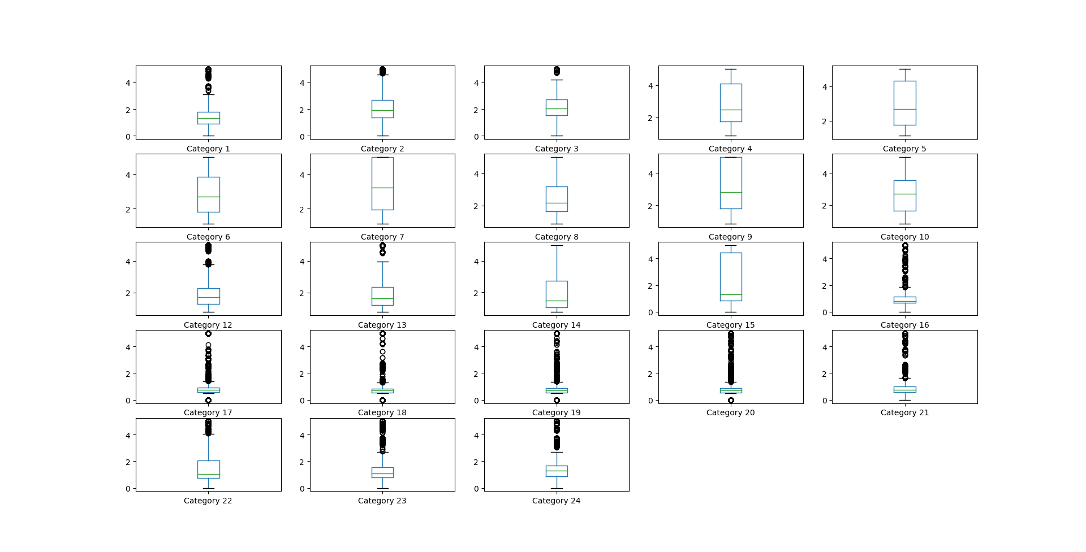
Visualization Overview

Slide 14
AGENDA
Introduction
Objective & Goal
Dataset description
Approach Design
Machine learning model
Results & Comparison - Python, R
Demo + AWS SageMaker
Conclusion
Future work & Technology used
*QR Code

Slide 15
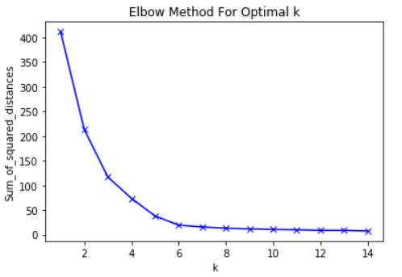
K-Means Algorithm
Choose no: of clusters
Initialization
Assign cluster
Move centroid
Optimization
Convergence
Within-cluster sum of squares is a measure of the variability of the observations within each cluster
Idea behind using elbow method to choose after which WSS is almost constant.

Slide 16
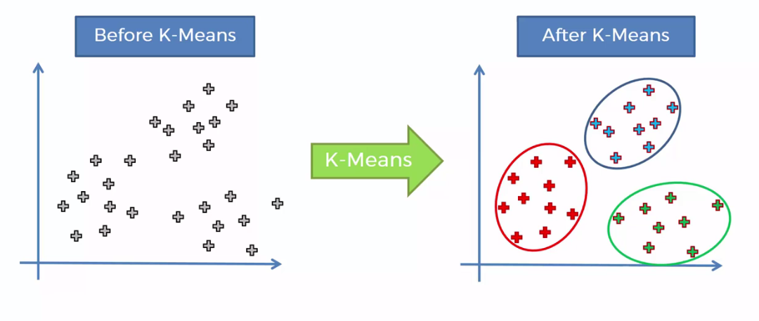
K-Means Algorithm
Choose no: of clusters
Initialization
Assign cluster
Move centroid
Optimization
Convergence
Initialize k points, randomly
Value of clusters are determined by elbow curve.

Slide 17
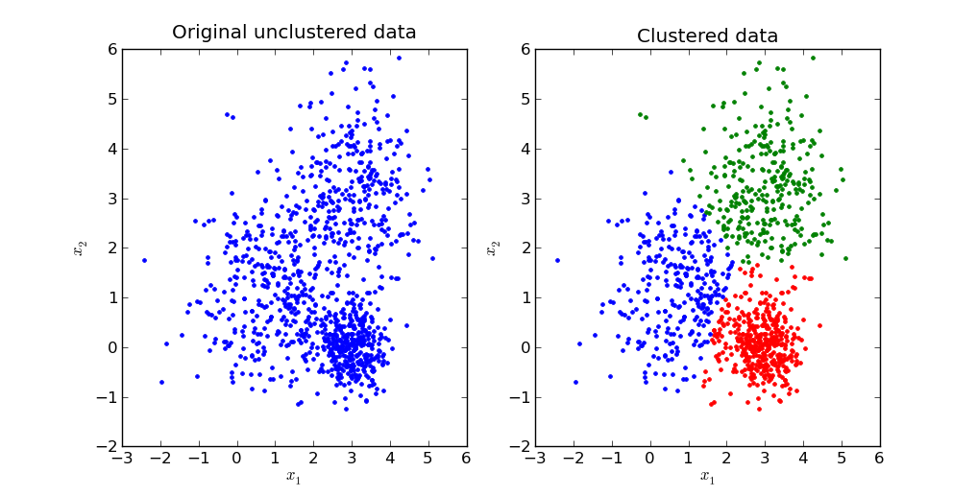
K-Means Algorithm
Choose no: of clusters
Initialization
Assign cluster
Move centroid
Optimization
Convergence
Dist. between data points and centroid are computed.
Based on min. Distance, data are divided into groups.

Slide 18
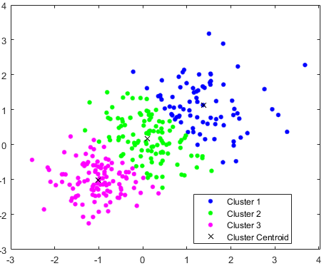
K-Means Algorithm
Choose no: of clusters
Initialization
Assign cluster
Move centroid
Optimization
Convergence
Compute the mean of all three dots.
Reposition blue, green, pink cluster centroid to this mean.

Slide 19
K-Means Algorithm
Choose no: of clusters
Initialization
Assign cluster
Move centroid
Optimization
Convergence
Redo the above steps till cluster stop changing their positions.

Slide 20
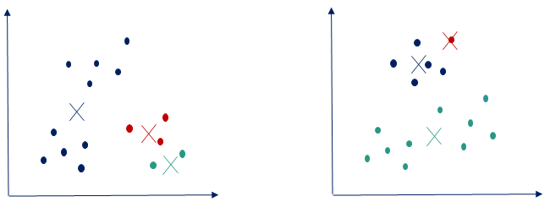
K-Means Algorithm
Choose no: of clusters
Initialization
Assign cluster
Move centroid
Optimization
Convergence
Divide the data points to clusters, once the algorithm converges.

Slide 21
AGENDA
Introduction
Objective & Goal
Dataset description
Approach Design
Machine learning model
Results & Comparison - Python, R
Demo + AWS SageMaker
Conclusion
Future work & Technology used
*QR Code

Slide 22
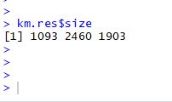
R - Libraries Used
library (cluster) - Finding groups in data.
library (ggplot2) - system for declaratively creating graphs.
library (factoextra) - Used to visualize clusters.

Slide 23
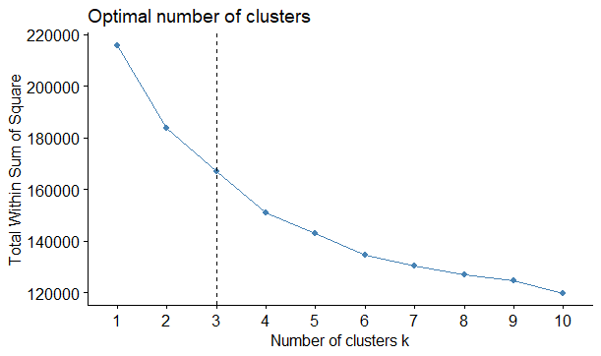
Results - R -
Method to validate the number of clusters is the elbow method.
Help finding the appropriate number of clusters in a dataset.
Here, 3 clusters are suggested.

Slide 24
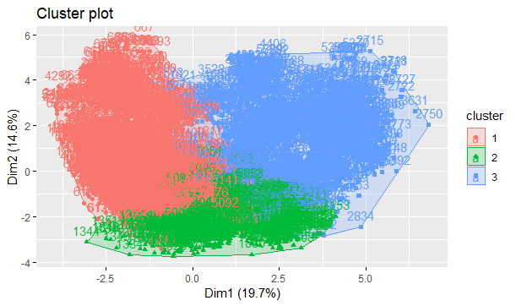
As it a multidimensional dataset, to visualize cluster plot PCA is used.
Reduce the dimensionality of a data set consisting of many variables correlated with each other

Slide 25
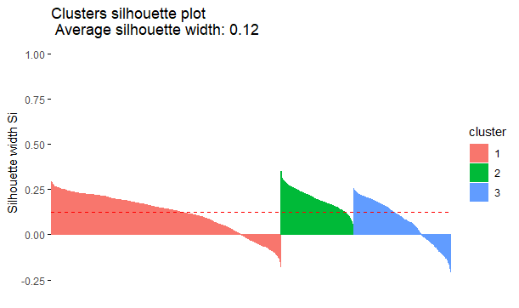

Silhouette Plot shows for each cluster:
Each vertical line corresponds to an element.
The average silhouette width

Slide 26
AGENDA
Introduction
Objective & Goal
Dataset description
Approach Design
Machine learning model
Results & Comparison - Python, R
Demo + AWS SageMaker
Conclusion
Future work & Technology used
*QR Code

Slide 27
Results - Python - elbow graph, clusters

Slide 28
Comparison

Slide 29
AGENDA
Introduction
Objective & Goal
Dataset description
Approach Design
Machine learning model
Results & Comparison - Python, R
Demo + AWS SageMaker
Conclusion
Future work & Technology used
*QR Code

Slide 30
Amazon SageMaker

Slide 31
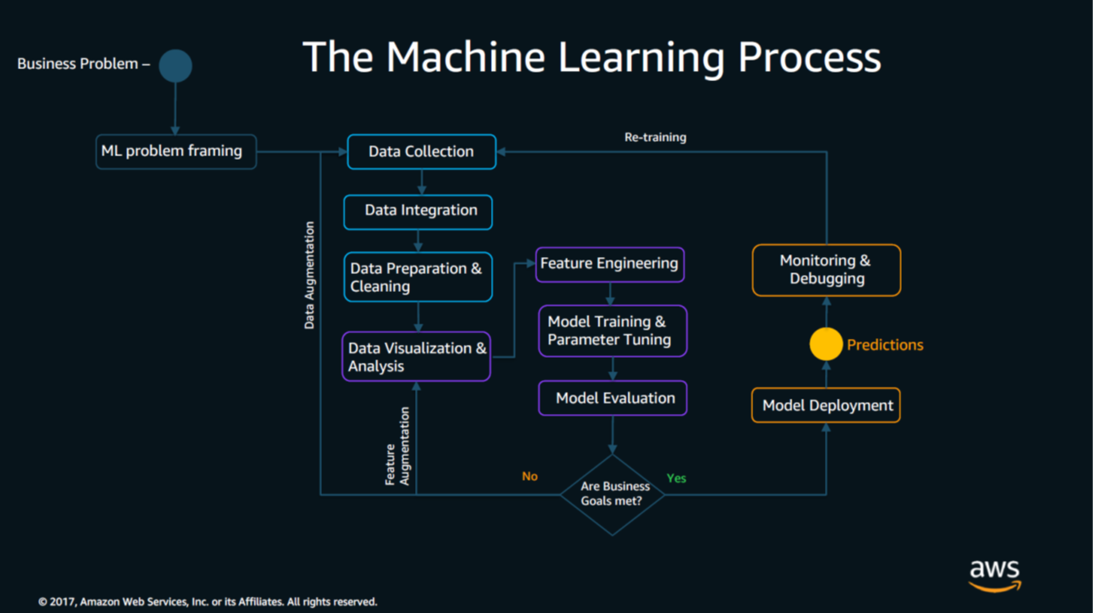

Slide 33
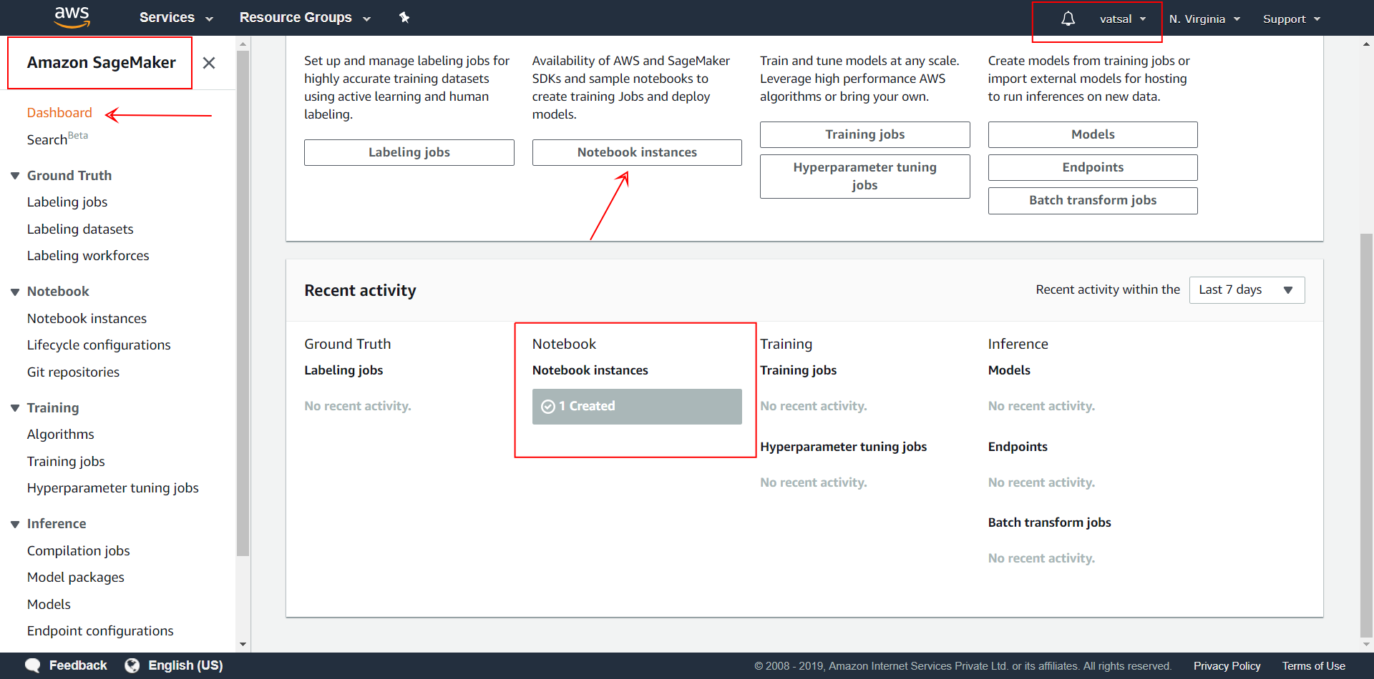

Slide 34
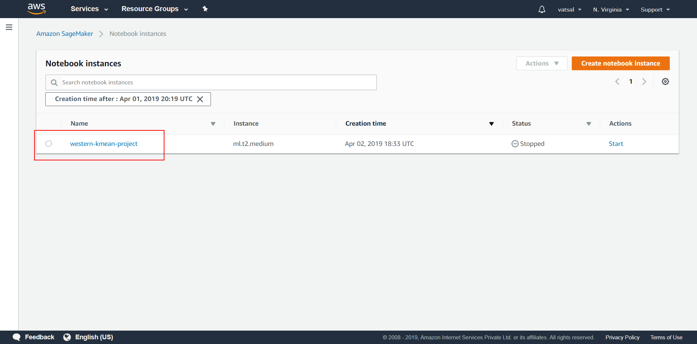

Slide 35
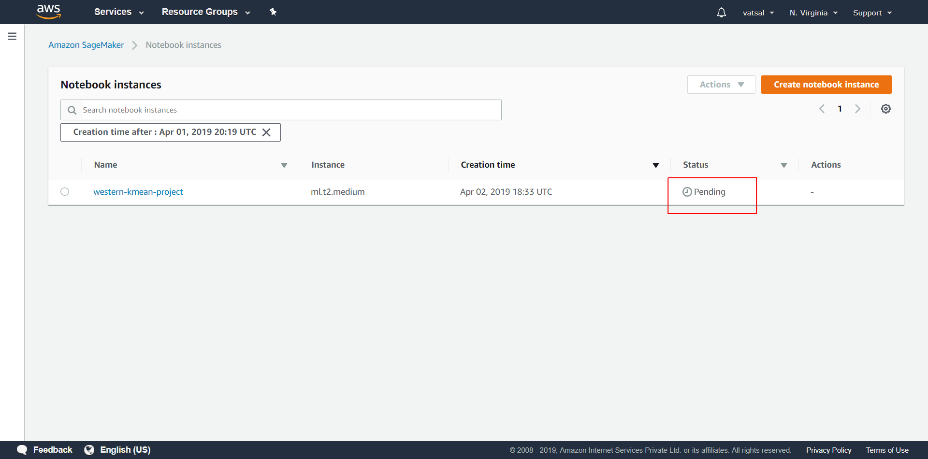

Slide 36
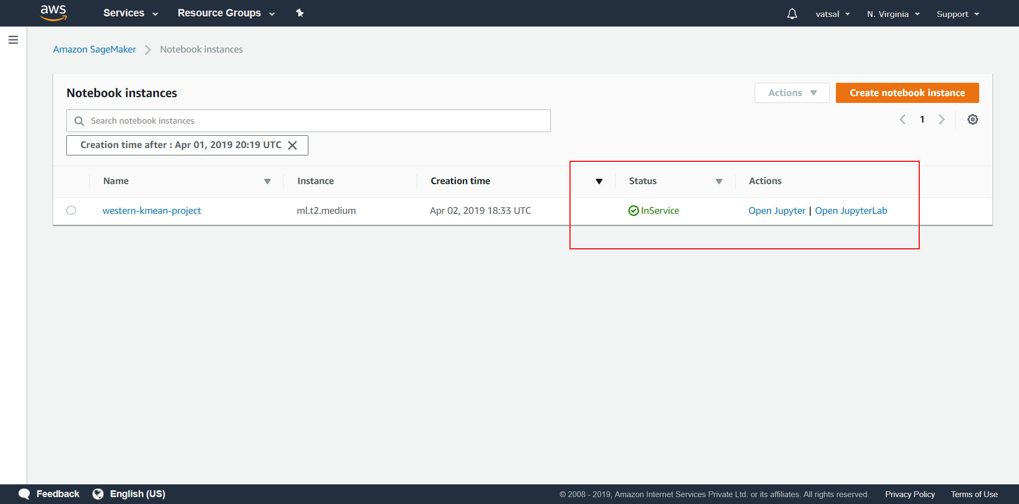

Slide 37
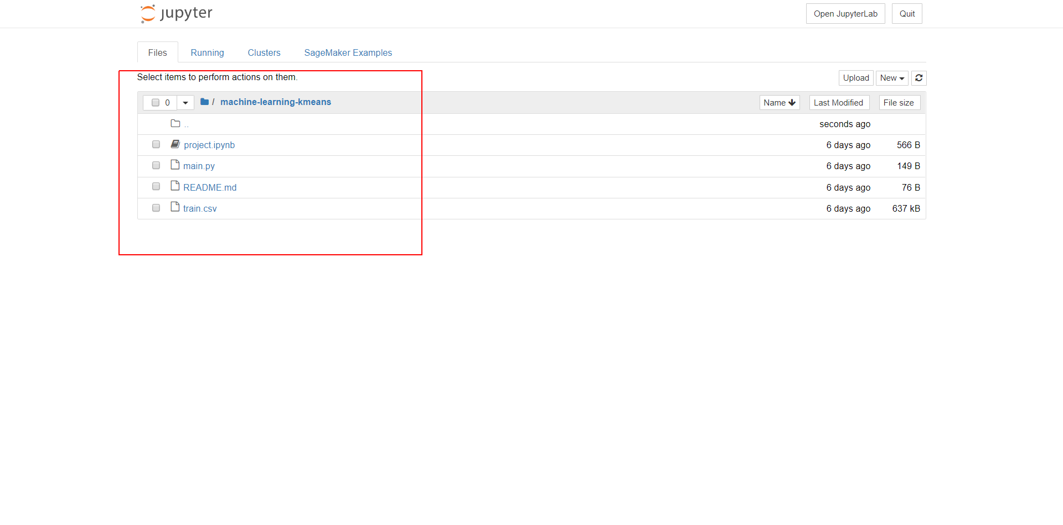

Slide 38
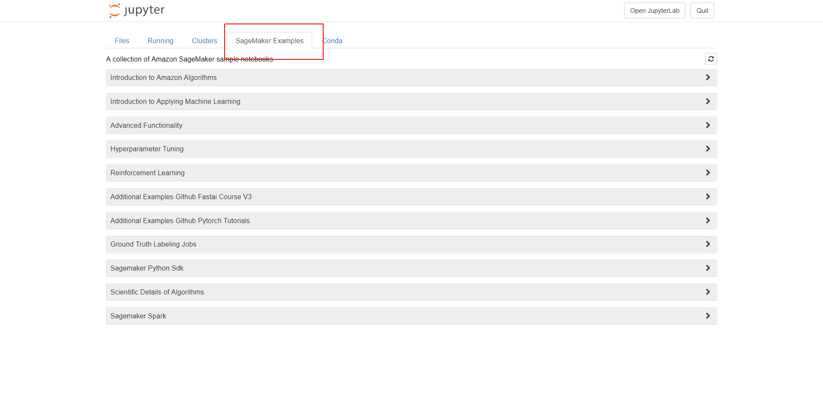

Slide 39
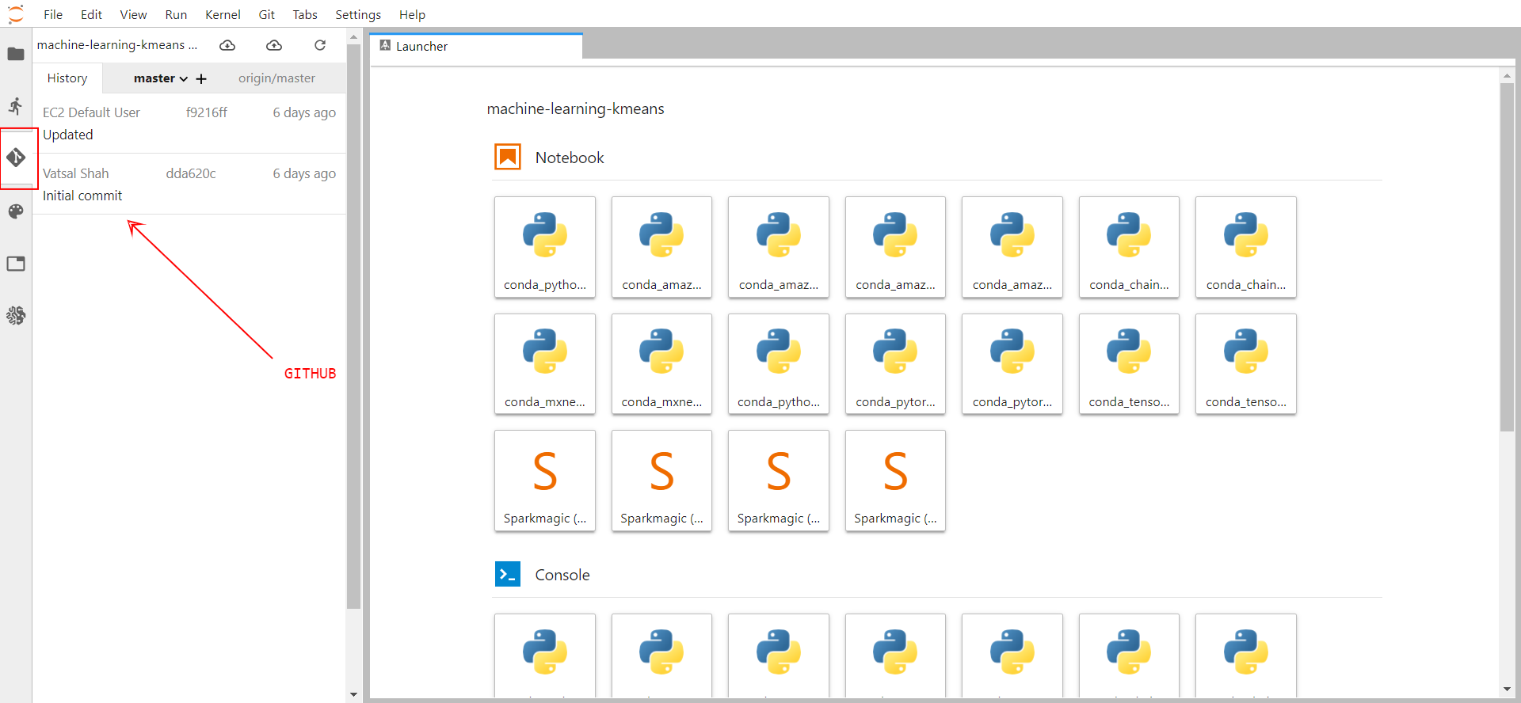

Slide 40
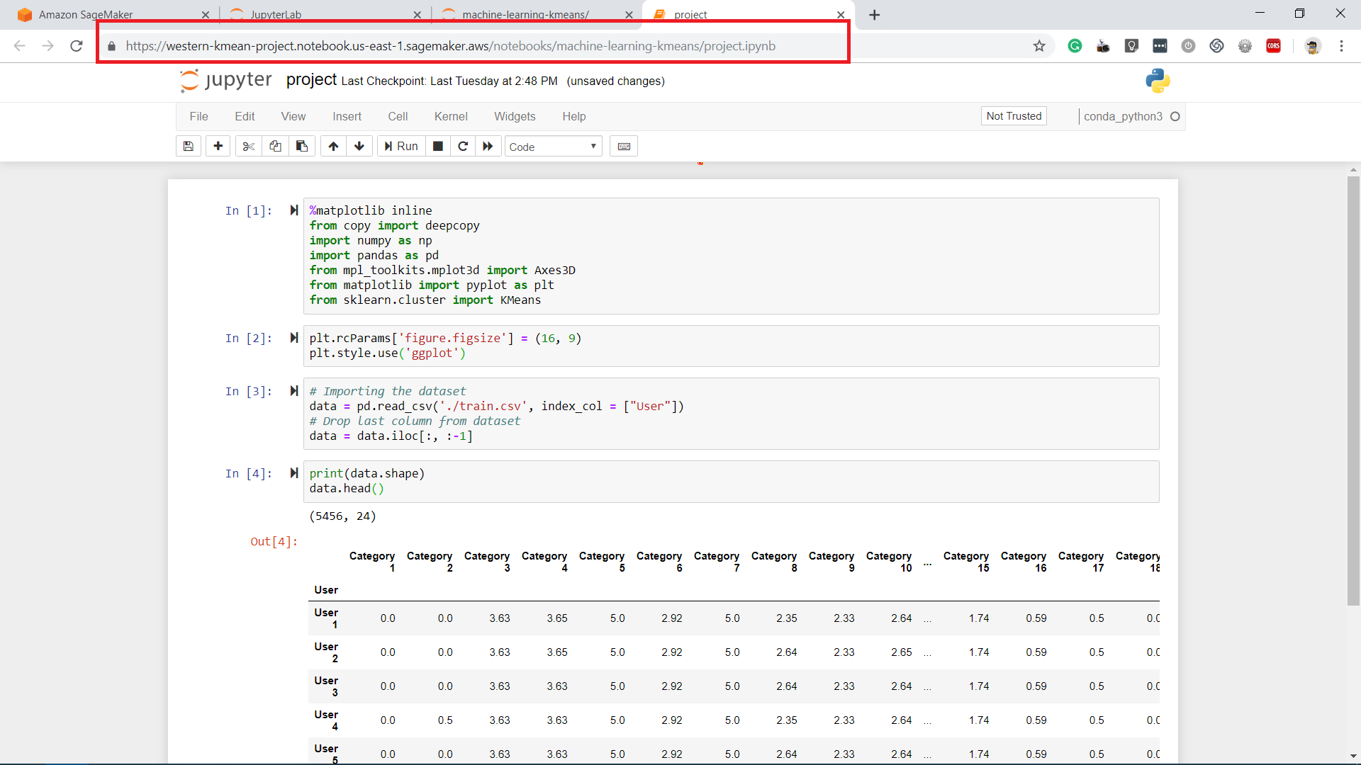

Slide 41
AGENDA
Introduction
Objective & Goal
Dataset description
Approach Design
Machine learning model
Results & Comparison - Python, R
Demo + AWS SageMaker
Conclusion
Future work & Technology used
*QR Code

Slide 42




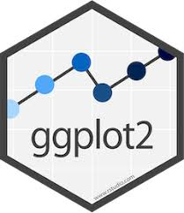
Technologies Used

Slide 43
AGENDA
Introduction
Objective & Goal
Dataset description
Approach Design
Machine learning model
Results & Comparison - Python, R
Demo + AWS SageMaker
Conclusion
Future work & Technology used
*QR Code

Slide 44
Future work
Find
Find more data and apply a model
Explore
Explore more about AWS SageMaker
Apply
Apply knowledge with real world expectation

Slide 45
AGENDA
Introduction
Objective & Goal
Dataset description
Approach Design
Machine learning model
Results & Comparison - Python, R
Demo + AWS SageMaker
Conclusion
Future work & Technology used
*QR Code

Slide 46
Resources:
Getting started with Amazon SageMaker: Link
Use the Amazon SageMaker SDK: Python: Link
SageMaker Examples: Link
Python vs R Comparison: Link
Python Libraries: Link
R Libraries : Link
K-means Algorithm: Link

Slide 47

QR Code
Scan QR code and access PPT and source code

Slide 48


Slide 49
THANK YOU

